Slide 1
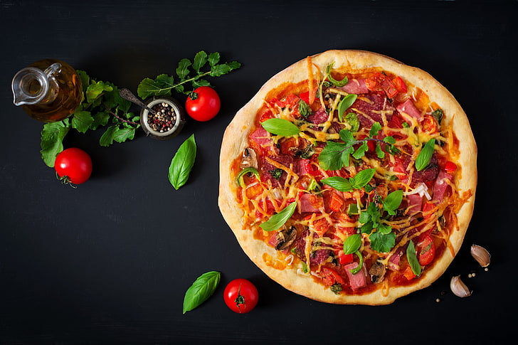
PIZZA SALES REPORT

Slide 2
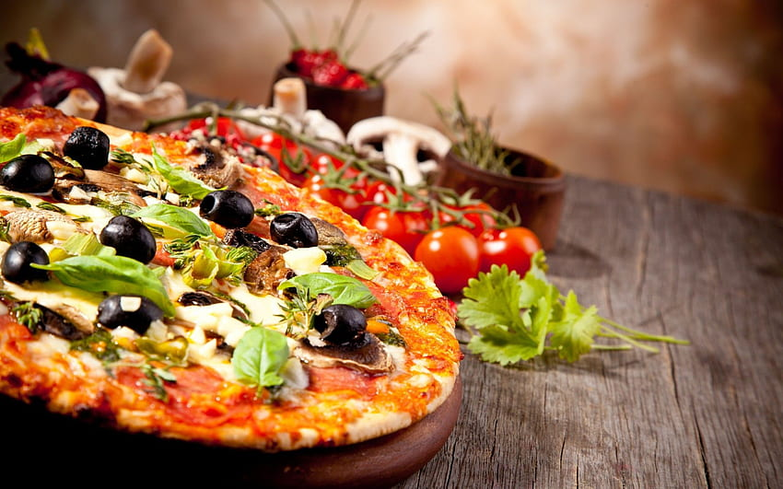
How many customers do we have each day? Are there any peak hours?
Average 60 customers Each day
Peak Hours : 12:00 pm to 1:00 pm & 5:00 pm to 6:00 pm

Slide 3
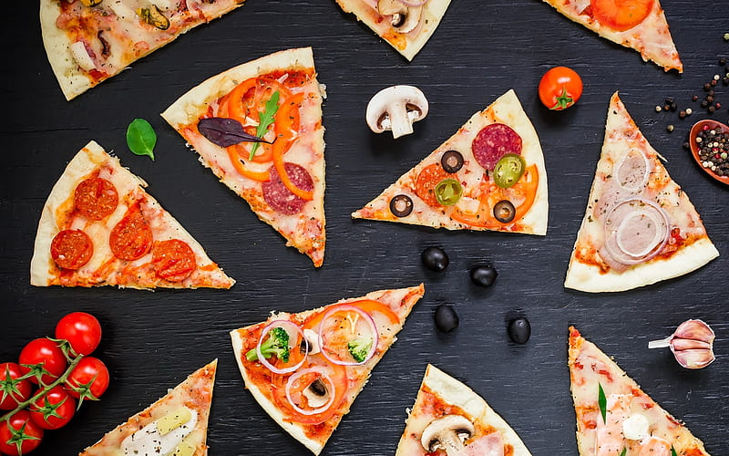
How many pizzas are typically in order? Do we have any bestsellers?
On an Average 3 Pizza per order are sold & "big_meat_s" is the Bestseller

Slide 4

How much money did we make this year? Can we identify any seasonality in the sales?
Total Revenue: ₹8,14,668.05
"November" has the highest and "December" has the lowest sell of Pizza

Slide 5
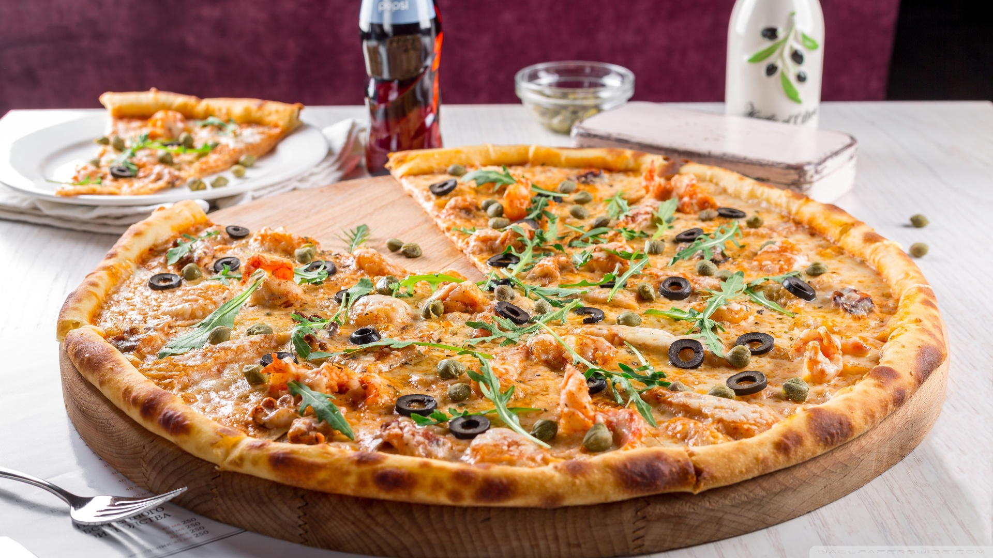
Are there any pizzas we should take off the menu, or any promotions we could leverage?
We can take off "the_greek_xxl" from our menu
We can give discount or any offer in off season to promote sales

